Slide 1
Team 3
Fitness Tracker App
William Barber
Eric Hernandez
William Hinkley
Dylan Smith
Jordon Young
Current as of 10 December 2023
Notes:
Billyl

Slide 2
Agenda
Processes (5-10 Min)
Vision Statement/Description
Process and Collaboration
Design and Planning
Development Tools
Tech Stack
Challenges
Demonstration (5-10 Min)
Login Page/Create/Account/About
Food Lookup
Exercise Lookup
Food Add
Exercise Add
Database
Render
Notes:
Billy

Slide 3
Vision Statement/Description
Balanced skills with interests and reasonable expectations
Scalability was a priority for flexibility and documentation purposes
Application to help users track and lookup foods and exercises
Nice database features with possible API usage
Enough space to allow independent and team work
Notes:
Billy

Slide 4
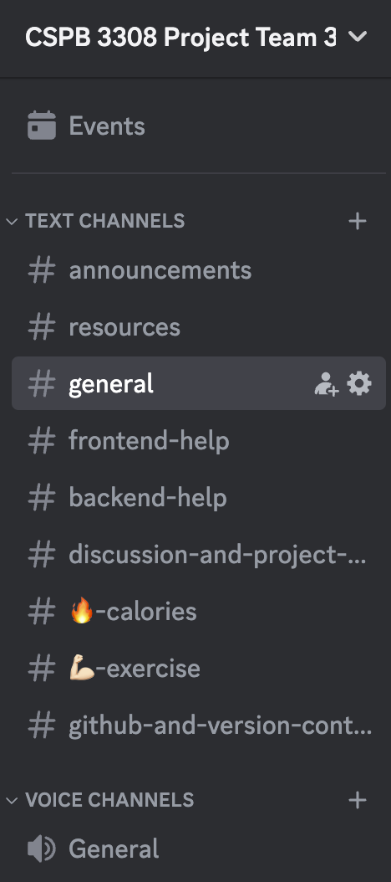

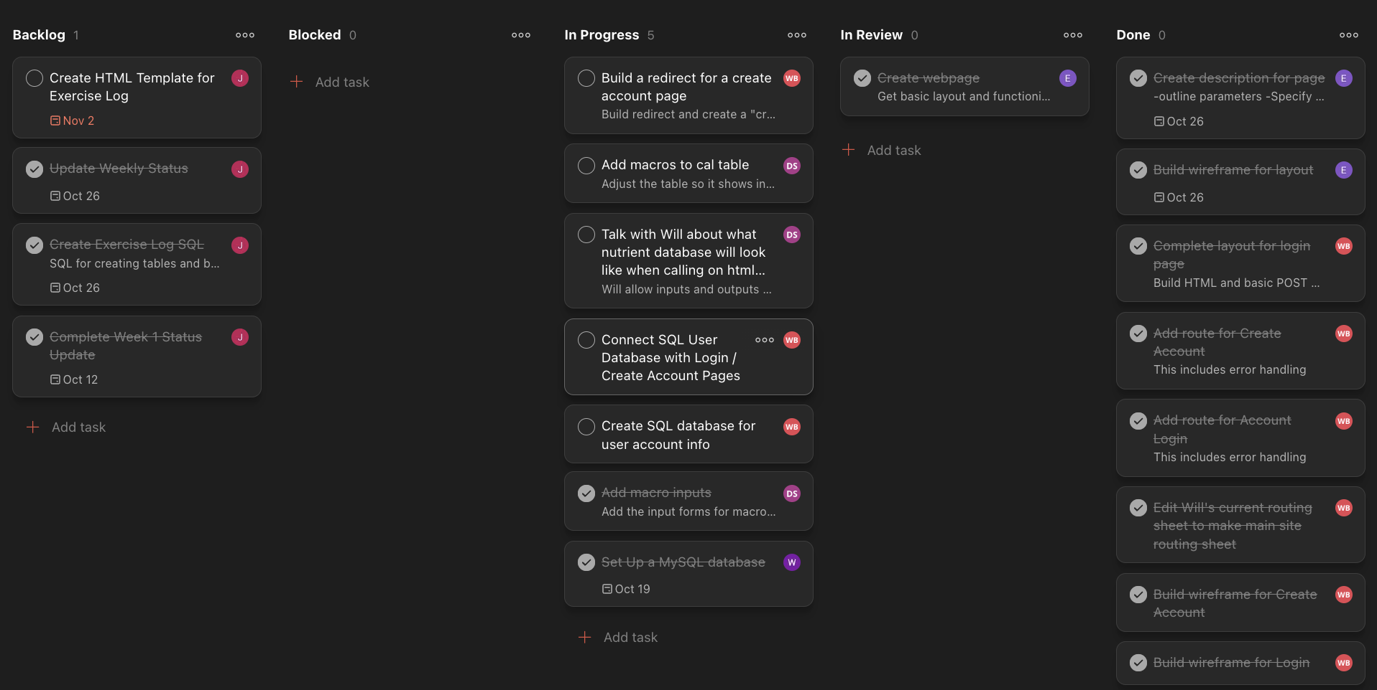

Process and Collaboration
1-Week Sprints & Weekly Stand Ups
Rotating Scrum Master
Project / Task Tracking in Todoist (Kanban Board)
Notes:
Process
Organized our work into weekly sprints
Weekly stand ups every thursday nights
Rotating scrum master schedule so everyone had the opportunity to be scrum master for a few weeks
Asynchronous Collaboration
Discord
All team communication and for weekly video meetings
Todoist
Project and task tracking
Kanban Board where we tracked status of tasks by column (backlog, in progress, completed)
Google Drive
For any team files outside of version control

Slide 5
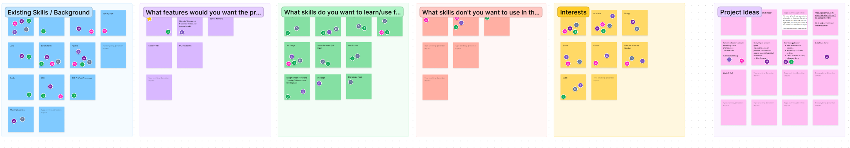
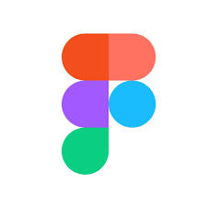
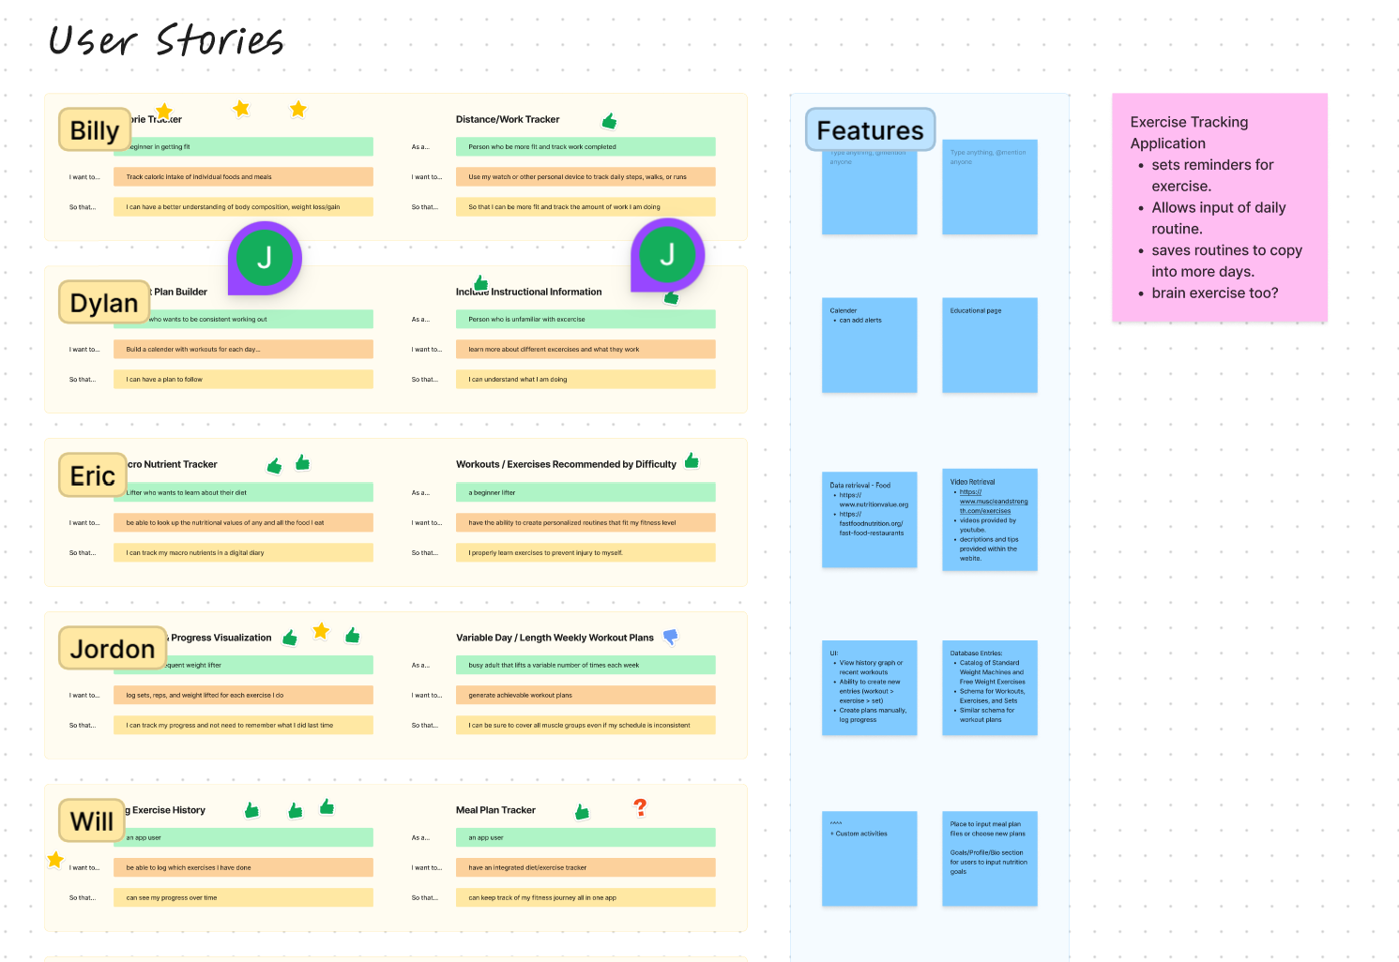
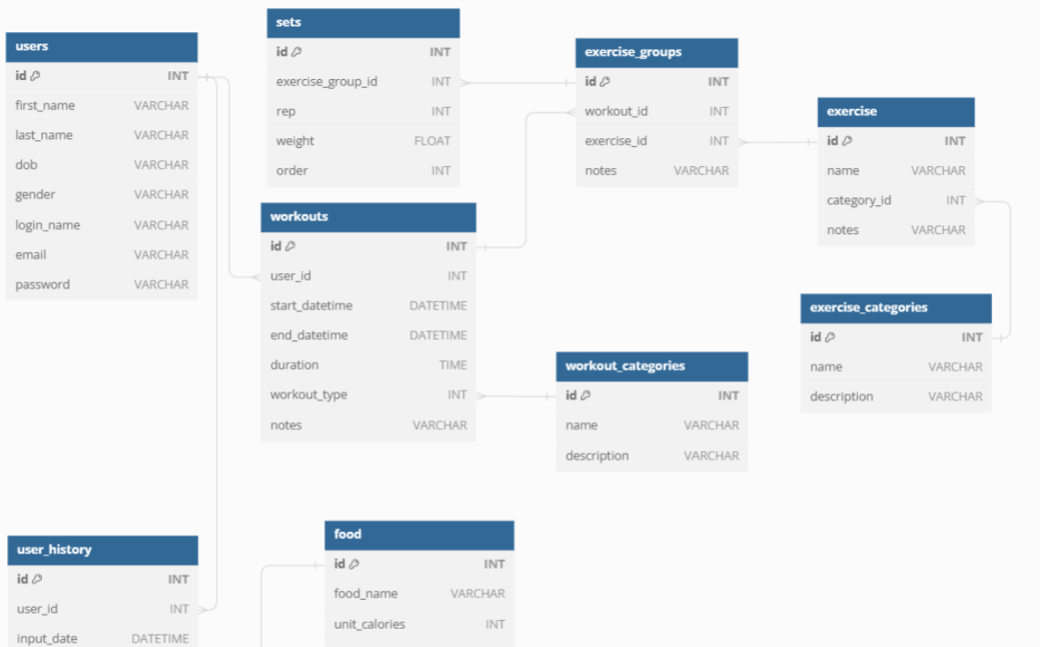
Design and Planning
Notes:
Figma
Collaborative design tool
Initial project planning and team exercises: gauging interests, skill assessment, feature discussion
Ideate user stories
DB Diagram
Design tables a build relationships for our database
Helps present database using tables, columns, keys, and relationships.
Next is Eric who will talk about our development tools and tech stack

Slide 6
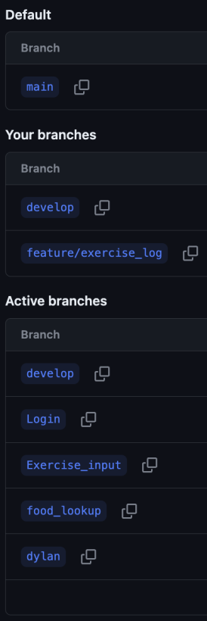
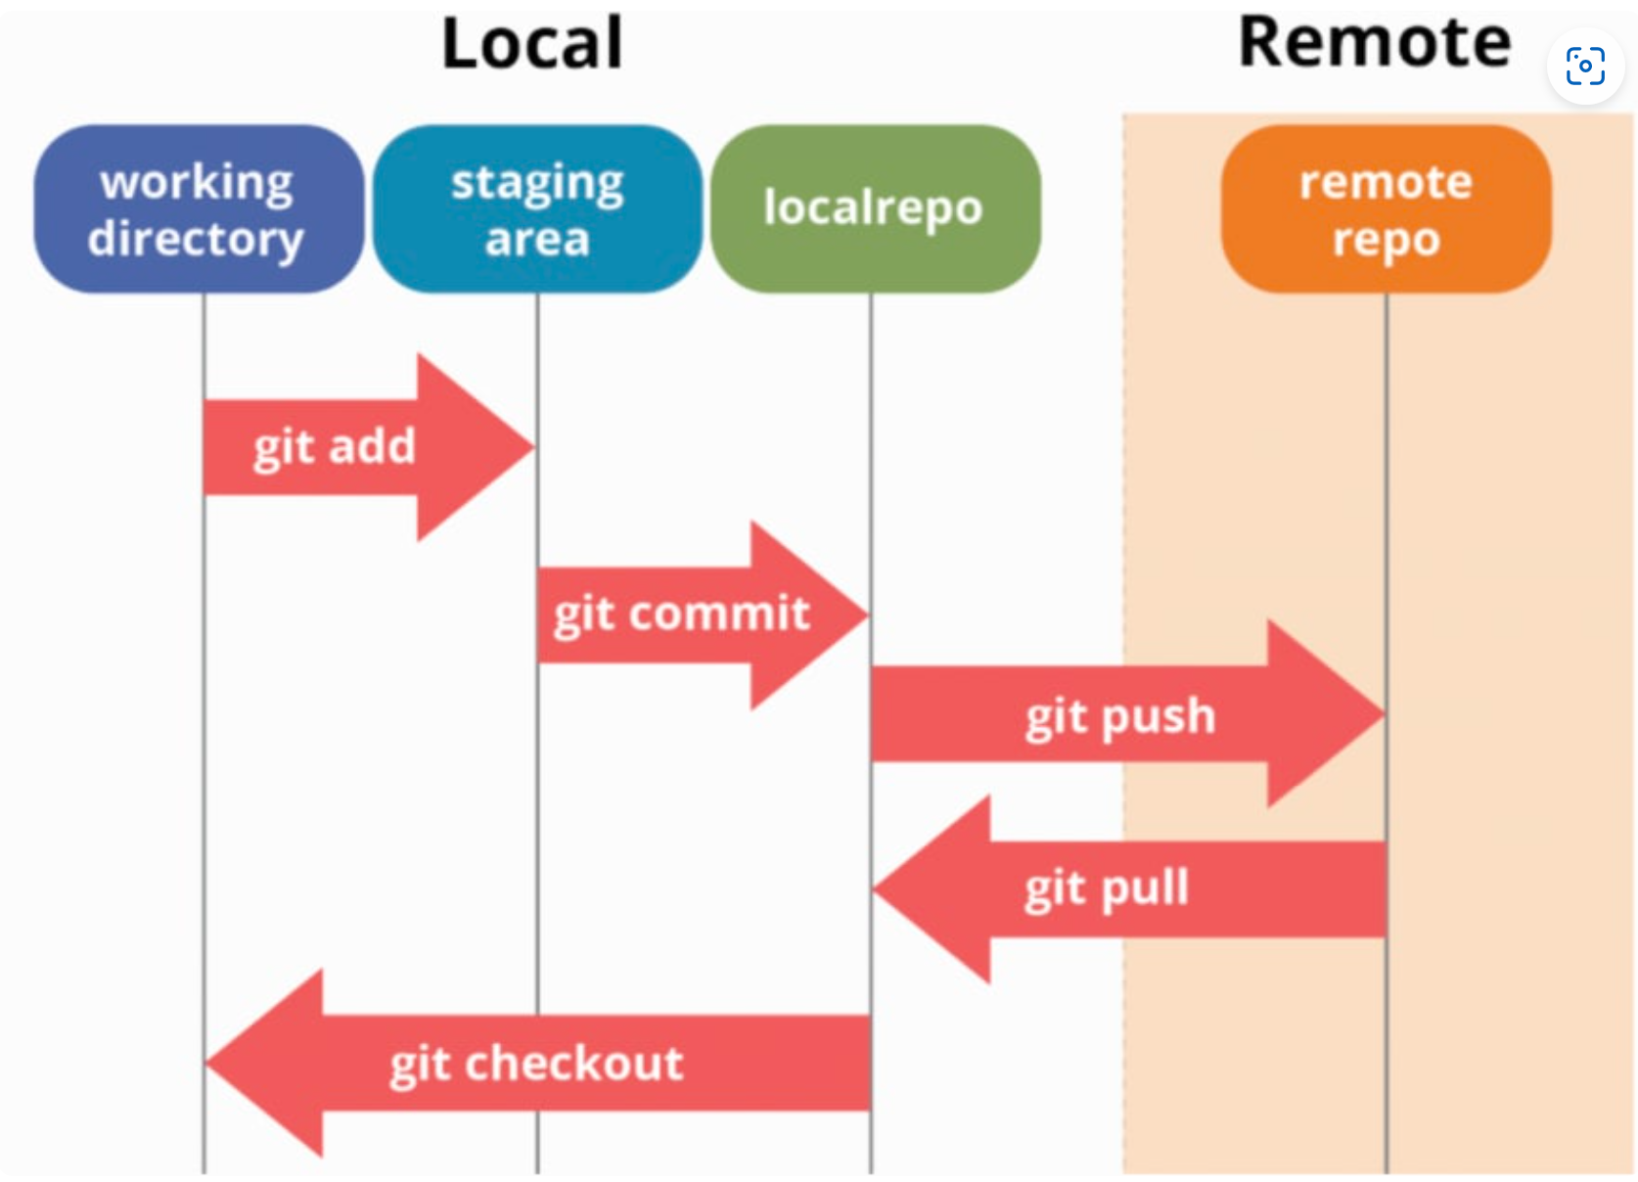
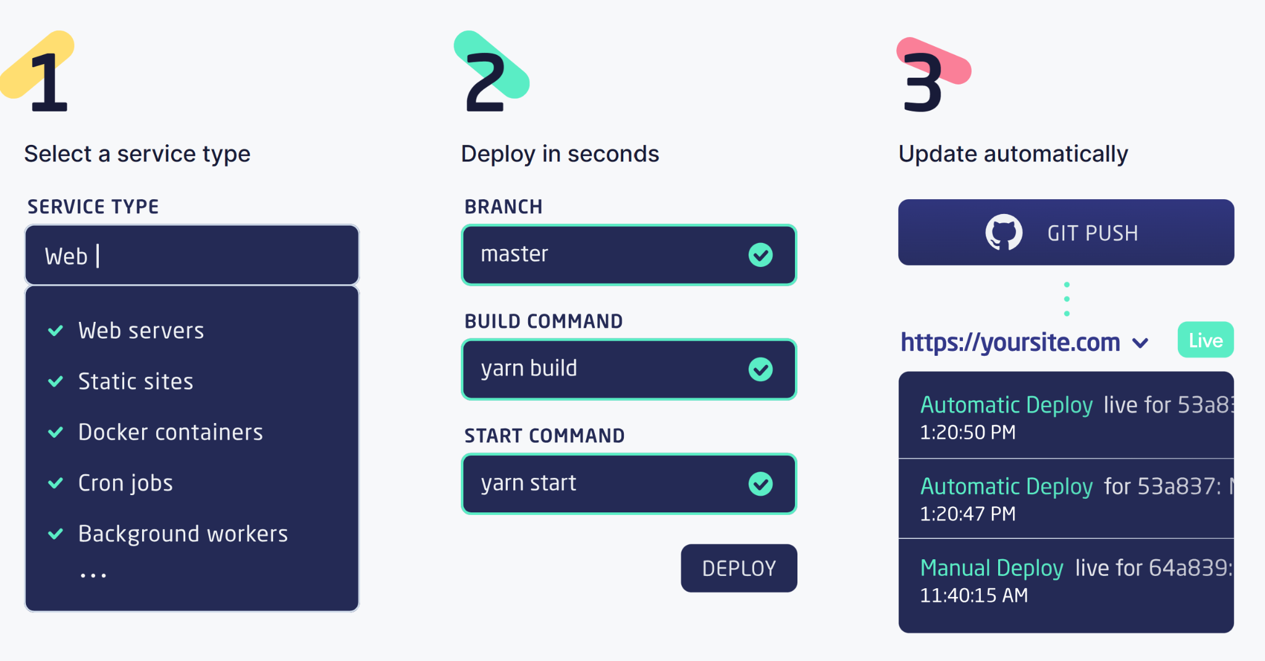
Development Tools
GitHub
Version control
Feature management
Render
Cloud computing platform for building and running web apps and websites
Notes:
Github:
Main platform for work and development
Gives a team of developers the ability to work independently and push features to one working branch…
It is a wonderful tool for the ability to pull locally and work in that independant environment without fear of breaking or deleting essential pieces .
Constant and effective contact is necessary when working on a single repository with many features, if a team is not careful then the task of merging all the branches together can slow down or halt the production process. It is essential to maintain repository structure for all team members.
Render:
We explored other deployment options such as GoDaddy, however render ends up being the best for our needs and is free for the basic uses.
Why render? (free service, pros/cons)
Render allows a simple PostgreSQL database creation, this can be done in just a couple of minutes.
Render allows direct communication to Github making the building, deployment, and editing of an application a smooth, quick process.
A con of render is that it limits the team to a single user to redeploy and read error messages that may occur, so that is an large inconvenience, but obviously can be worked around.
Another small “con” of Render, only because it was an extra step for us, was that we all initially wrote our app in sqlite3 so we had to make the language switch over to PostgreSQL. Not that it is a difficult task, but If we were to work on a project like this again, we would right off the bat the final expectation of language implementation.

Slide 7
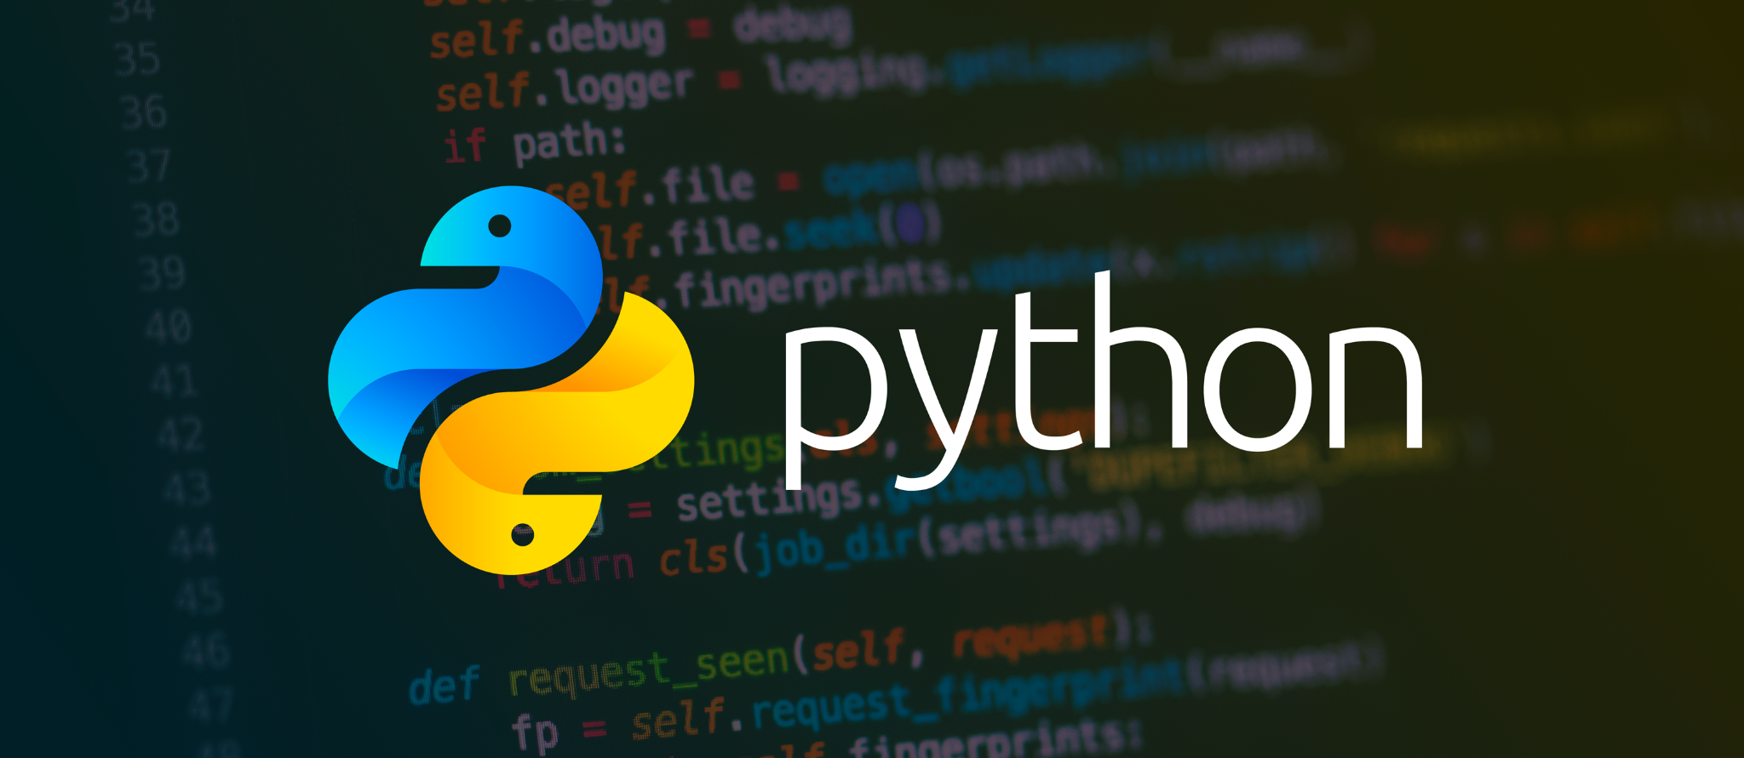


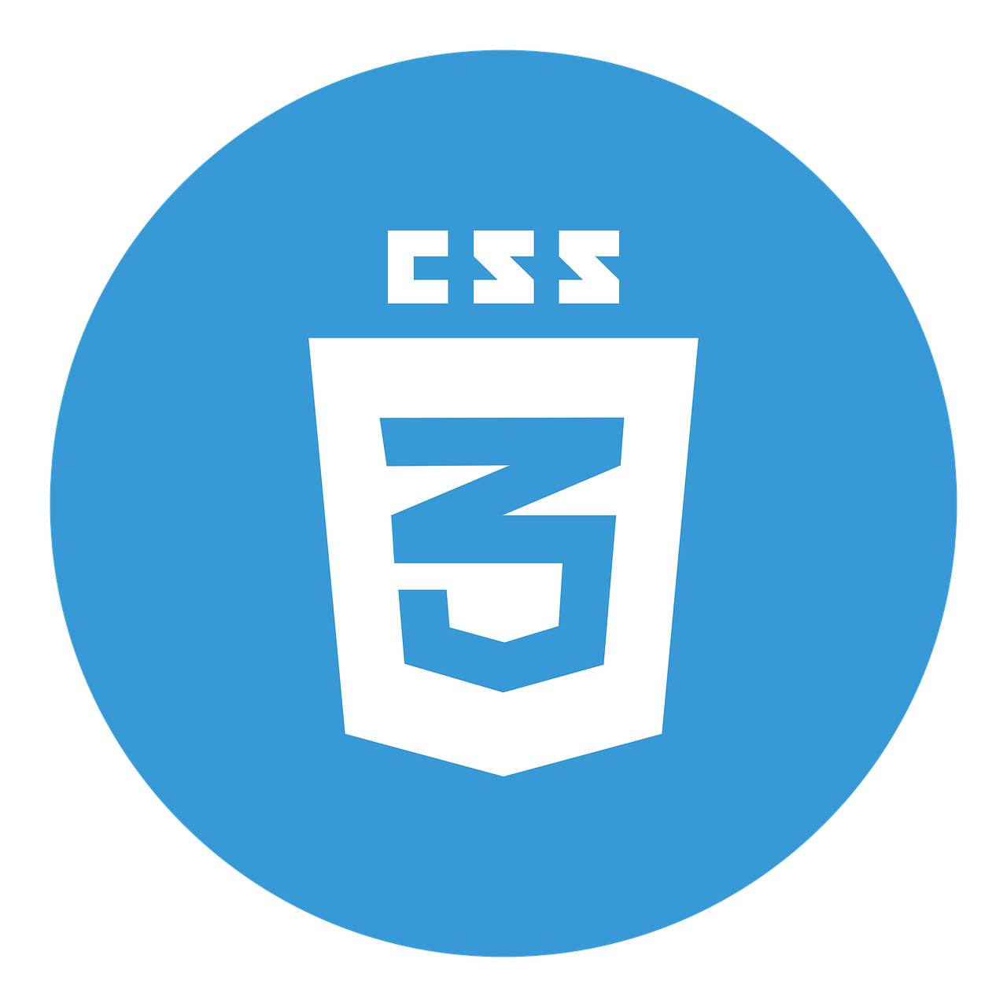

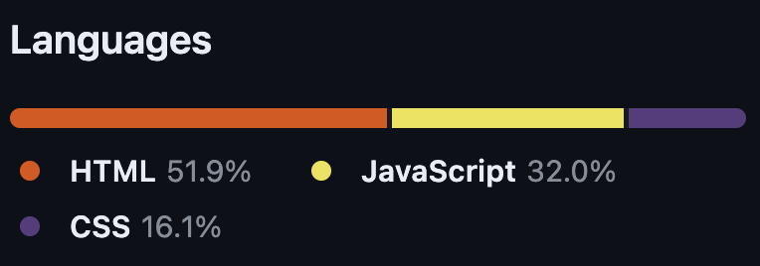

Tech Stack
*Python strangely not included in line counts
Notes:
Python: Used for developing our web application.
Flask: A micro web framework that is written in Python and is used for building web applications. (Microweb = does not require specific tools or libraries)
PostgreSQL: A relational database management system that is used for storing data in web applications.
HTML: The language we used for creating our web pages.
CSS: A style sheet language that is used for describing the presentation design of a HTML page.
JavaScript: The language we used for turning a static webpage into an interactive one.
These tools are used to build the front-end and back-end of a web app. Python and Flask are used for the back-end, while PostgreSQL is used for the database. HTML, CSS, and JavaScript are used for the front-end.
(Is there time?...)
As a team I would rate everyone extremely high on their ability to learn and implement new tools and really push themself. That being said Dylan will go on for here and talk about where we did find challenges.

Slide 8
Version Control
Project split into 5 portions
Branch for each person/focus area to mitigate issues
Managed a Develop Branch in addition to main
Forked to Render
Strategy was favorable but more work on end for merging
More folder structure would have been beneficial but all were learning

Slide 9
Challenges
Time
Level of understanding
Expectations
Communication
Notes:
Add something good about each of the challenges. How we overcame it or what we learned from it.

Slide 10
(Also Challenges)
Back end of semester was heavy for merging branches
Ultimately decided on Render even though other HAAS were explored
Torn on strategy of combined files or separate files with a Makefile
JupyterHub makes difficult hosting environment
Debugging Heavy and can take multiple steps back before moving forward
Team Building (Forming, Norming, Storming, Performing)
Diversity and the ladder of inference
Knowledge and Skill level

Slide 11
Demonstration
Demo: https://youtu.be/YS46r0HW-S0

Slide 12
Questions?

Slide 13
Road Map/Way Forward
We envisioned a fleet of battleships and built a canoe
We wanted to document and leave room for growth
Importance on future contributions and a roadmap to get there
Implement Better Security
Implement smoother page integration
Improve the aesthetics of the site

